Slide 1



Slide 2
Digital Forensics Degree from the University of East London, UK
Computer Forensic Analyst (Punjab Forensic Science Agency)
Founding member of the Digital Forensic Community in Pakistan.
Forensic Consultant for Sindh and Khyber Pakhtunkhwa Forensic Laboratory.
Case worked:
Blasphemy
Corporate fraud
Data leak
Banking fraud
Terrorism
Pornography
Murder
IED’s (improvised explosive device)
Presented by
Faraz Ali
Forensic Scientist, Analyst & Investigator

Slide 3
Certified Ethical Hacking

Slide 4
Course Intro: 3-Month Journey
A comprehensive path from foundational security to advanced penetration testing.

Slide 5
"Cybersecurity is much more than a matter of IT—it’s a business imperative."
— Stéphane Nappo, Global CISO

Slide 6
The Global Cybersecurity Talent Gap
4.8M
Information Security Analysts are among the top 15 fastest-growing roles. Companies are struggling to find "Battle-Ready" talent with the ethical hacker mindset.
Unfilled Jobs Globally by 2026

Slide 7
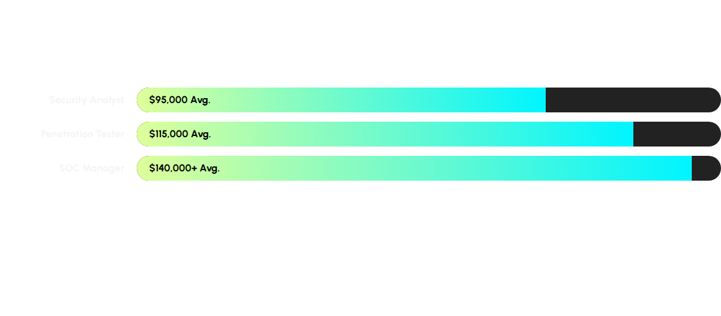
Salary Benchmarks: Market Growth
Certification in CEH often leads to a 20-25% increase in immediate earning potential.

Slide 8


Defining the Ethical Hacker
The "White Hat" Guard
Authorized professionals identifying vulnerabilities.
Acts as the "immune system" of digital infrastructure.
Operates strictly with written Authorization.
Focuses on remediation and defensive posture improvement.

Slide 9






The Five Domains of Cyberspace
Public
Private
Military
Internet-facing infrastructure and open communication.
Intranets, internal datasets, and corporate assets.
Secured defense networks and intelligence systems.

Slide 10


Understanding the Hat Palette
The Taxonomy of Intent
White Hat: Full authorization, ethical goals.
Black Hat: Malicious intent, illegal activities.
Gray Hat: Unauthorized entry but often without malicious intent (Curiosity/Bounty).
Blue Hat: Outside security testers invited to find bugs before a launch.

Slide 11



Profiling Advanced Threat Actors
State-Sponsored
Red Hats
Suicide Hackers
Nation-state units targeting critical infrastructure.
Vigilantes using aggressive tactics against black hats.
Destructive actors with no fear of capture or consequences.

Slide 12
The Four Stages: Virus Lifecycle
Dormant
Propagation
Triggering
Execution
Hidden in host system awaiting trigger.
Replicating across files and networks.
Logic bomb condition is finally met.
Payload delivers malicious damage.

Slide 13
Classifying Modern Malware
Memory-Resident: Lives in RAM, evading traditional disk-based scanners.
Macro Viruses: Exploits scripting capabilities in Office documents.
Direct Action: Executes immediately upon file launch and then vanishes.
Stealth Malware: Actively hides its presence from anti-virus detection engines.

Slide 14



Anatomy of a Digital Virus
Infection Vector
The Trigger
Malicious Payload
The mechanism used to spread (Email, USB, Web).
The specific condition that activates the virus.
The actual code that performs the harmful action.

Slide 15

Social Engineering: Phishing
Beyond Email
Phishing: Bulk fraudulent emails to steal credentials.
Vishing: Voice-based phishing using AI deepfakes.
Smishing: SMS-based attacks targeting mobile users.
Quishing: Malicious QR codes leading to fake login pages.

Slide 16
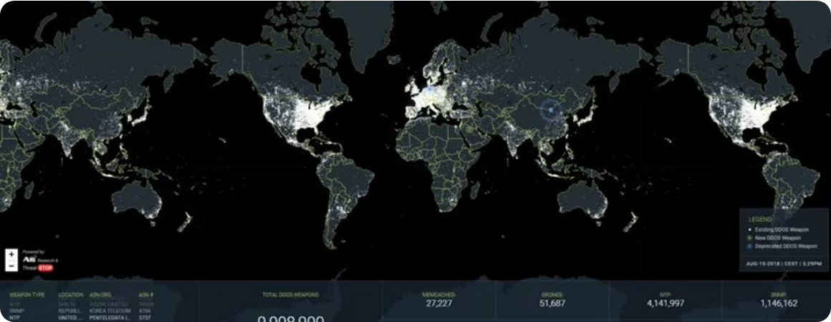
DoS and DDoS Attack Trends
DDoS volume has increased by 150% YoY, with 2026 seeing the rise of AI-coordinated botnets.

Slide 17






Man-in-the-Middle Operations
Digital Eavesdropping
Attacker intercepts communication between User and Server.
Enables data sniffing, credential theft, and data alteration.
Common via ARP Poisoning and Rogue Wi-Fi Hotspots.
Countermeasure: Robust end-to-end encryption (TLS/SSL).

Slide 18
The 5 Phases of Ethical Hacking
Recon
Scanning
Access
Maintain
Cleanup
A disciplined, repeatable methodology used by professional penetration testers.

Slide 19






Phase 1: Reconnaissance Toolset
theHarvester
Maltego
Google Dorks
Open source intelligence for gathering emails and subdomains.
Graphical tool for mapping infrastructure and human relationships.
Advanced search operators to find sensitive exposed data.

Slide 20


Phase 2: Scanning & Enumeration
Mastering Nmap
-sV: Service version detection.
PORT STATE SERVICE 80/tcp open http 443/tcp open https 22/tcp open ssh
-O: Operating System fingerprinting.
-A: Aggressive scan (Scripts, OS, Traceroute).
-p-: Scans all 65,535 ports.

Slide 21
Vulnerability Analysis Platforms
Platform | Type | Core Functionality
Nessus | Network | Global gold standard for enterprise vuln assessment.
Nikto | Web Server | Checks for dangerous files and outdated server software.
OpenVAS | Open Source | Framework of several services for vuln scanning.
OWASP ZAP | Web App | Proxy-based tool for intercepting web traffic.

Slide 22

Phase 3: Gaining Access
Metasploit Framework
The world's most used exploitation framework, providing developers and security professionals with the tools to find, exploit, and validate vulnerabilities.
msfconsole use exploit/unix/ftp/vsftpd_234_backdoor set RHOSTS [target] exploit

Slide 23



Password Cracking Methodology
Dictionary
Brute Force
Custom Rules
Testing millions of words against hashes.
Trying every possible character combination.
Mutilating words (e.g., adding "2026!") for efficiency.

Slide 24

Identifying Hashing Algorithms
Prefix | Algorithm | Example Structure
$1$ | MD5 | $ 1 $ hash...
$5$ | SHA-256 | $ 5 $ hash...
$6$ | SHA-512 | $ 6 $ hash...

Slide 25
Phase 4: Maintaining Access
Backdoors: Establishing hidden listeners for future unauthorized entry.
New Admin Accounts: Creating silent administrative profiles to bypass standard logins.
Rootkits: Deep-level software that hides itself and other malware from the OS.
Lateral Movement: Moving from the initial target to other network segments.

Slide 26



Phase 5: Clearing Tracks
Log Erasure
Timestomping
Tool Removal
Deleting entries in /var/log/ or Windows Event Logs.
Modifying file access/edit times to confuse forensics.
Securely deleting all scripts and binaries used in the hack.

Slide 27
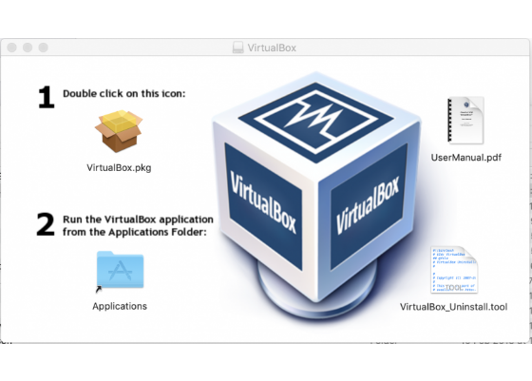
Cloud Security: Responsibility
Shared Responsibility
In the cloud, security is shared:
Provider: Security OF the Cloud (Hardware/Infrastructure).
Customer: Security IN the Cloud (Data, OS, Config).

Slide 28

Protecting Critical Infrastructure
OT (operational technology )and SCADA (supervisory control and data acquisition)
Operational Technology (OT) controls physical processes.
Vulnerabilities in power grids, water, and transport.
Legacy hardware often lacks modern authentication.
Convergence: IT and OT networks are merging, increasing risk.

Slide 29



Building a Professional Lab
Hardware
Sandbox
Targets
16GB+ RAM, Multi-core CPU, 256GB SSD Minimum.
VirtualBox or VMWare for isolated execution.
Metasploitable 2 and DVWA for safe practice.

Slide 30

Kali Linux: The Tool Ecosystem
4,000+ Tools: Pre-installed security arsenal.
Open Source: Completely customizable Debian-based OS.
Live USB: Can be run in forensics mode without touching disk.
ARM Support: Compatible with Raspberry Pi for portable hacking.

Slide 31
The CEH v13 Exam Strategy
125
20
Knowledge Questions (4 Hrs)
Practical Tasks (6 Hrs)
Successfully passing both identifies you as a **CEH Master**.

Slide 32

Questions & Answers
THANK YOU FOR YOUR ATTENTION

Slide 33






Image Sources
https://media.istockphoto.com/id/1322051647/vector/black-white-incognito-hat-and-eyeglasses.jpg?s=612x612&w=0&k=20&c=QOHvFwPcSyNfrVeWzqMviKljzjX0DYMmADS-9UMf6Xs=
Source: www.istockphoto.com
https://static.vecteezy.com/system/resources/previews/067/827/004/non_2x/hi-tech-circuit-background-with-glowing-lines-blue-digital-network-on-dark-gradient-ideal-for-innovation-computing-and-futuristic-interfaces-clean-cyber-pattern-and-layout-illustration-vector.jpg
Source: www.vecteezy.com
https://static.vecteezy.com/system/resources/thumbnails/075/998/760/large/an-envelope-hanging-from-a-sharp-metal-hook-serves-as-a-visual-metaphor-for-email-phishing-or-a-potential-digital-security-threat-free-video.jpg
Source: www.vecteezy.com
https://img.nomios.com/images/Partners/A10-networks/ddos-attack-world-map-a10-networks.webp?auto=compress%2Cformat&fit=max&fm=jpg&q=70&w=2800&s=9a7ac90e53531d7e5038e9dc383b3ed0
Source: www.nomios.lu
https://www.kali.org/tools/metasploit-framework/images/metasploit-framework-logo.svg
Source: www.kali.org
https://www.egr.msu.edu/decs/sites/default/files/content/Virtualbox/VB1_0.png
Source: www.egr.msu.edu

Slide 34



Image Sources
https://www.lianjer.com/wp-content/uploads/2025/10/Futuristic-SCADA-system-interface-with-AI-automation-and-cybersecurity-icons-around-central-control-hub.webp
Source: www.lianjer.com
https://i.sstatic.net/Gns38.png
Source: unix.stackexchange.com
https://www.nicholls.edu/continuing-ed/wp-content/uploads/sites/32/2022/06/Screen-Shot-2022-06-02-at-8.30.38-AM-400x388.png
Source: www.nicholls.edu

